Slide 1
Credit Card Customer Segmentation based on Customer Purchase Behaviour
S.A.M.V. SWETHA

Slide 2
Abstract
Segmentation in business is used to divide customers based on attributes such as behaviour or demographics, in order to provide improved consumer experiences
The credit card dataset used for the analysis summarizes the usage behaviour of about 9000 active credit card holders during the last 6 months. As per my research question, in order to identify and segment customers - I chose to apply K-Means clustering based on their purchase history, credit limit and balance
As part of the analysis, optimum number of clusters were calculated using elbow plot, various purchase behaviours were identified using purchase history, clustering was performed using K-Means where-in customers were segmented into Max Payers, Money borrowers, Traders and potential riskers, which can be used to define bank’s marketing strategy

Slide 3
Motivation
In today’s competitive financial markets, it is essential to have good customer understanding to increase customer lifetime value. The goal of customer segmentation is to group customers by common characteristics to identify profitable, risky segments and enable companies to target each segment with specific offerings
The focus of this analysis is on business strategy driven customer segmentation, to identify various payment behaviours of customers. Present analysis segments bank customers into Max Payers, ordinary users, money borrowers, Revolvers, Traders, potential riskers
The information is not only helpful for the bank to understand related characteristics of different customers, but also for the marketing representatives to find potential customers and implement target marketing

Slide 4
Dataset(s)
CreditCard Dataset from ‘kaggle’ is used for the analysis which summarizes the usage behaviour of about 9000 active credit card holders during the last 6 months, constitutes around 900 KB
The dataset consists of 18 features about the behaviour of credit card customers. These include variables such as the balance currently on the card, the number of purchases that have been made on the account, the credit limit, and many other attributes which define customer purchase and payment behaviour
A complete data dictionary can be found on the data download page
Notes:
Describe your dataset(s) here. You should say what data is in the dataset, how much data, and where you found the dataset (if applicable).

Slide 5
Data Preparation and Cleaning
Data Cleaning was performed to check the missing/corrupted values
MINIMUM_PAYMENTS and CREDIT_LIMIT columns were identified with (313,1) null values respectively, which were then imputed with zero and median values
Columns such as CUST_ID are dropped and the input dataset is normalised using Standard Scaler function

Slide 6
Research Question(s)
Which segments of customers are most likely to make payments on time and delay the payments?
Which segment of customers can be identified as Max Payers, Potential Riskers, Revolvers, Money Borrowers and Traders?
What are the distinct purchasing behaviours of customers that can be identified from the dataset?
Based on the purchasing behaviour, Which of these categories do the customers fall into – early payments or late payments?

Slide 7
Methods
Firstly, the optimal number of clusters for the K-Means algorithm is found using the ’Elbow Method’ which computes the sum of squared distances for k clusters
The ‘K-Means Algorithm’ is used which divides the dataset into 6 clusters by segregating customers with similar payment behaviour into the same cluster
Based on the trends of purchase history and credit limit, customer payment behaviour is predicted for each cluster, and can be used for target marketing
The purchase history data from the dataset is used to define distinct purchase behaviours, using which the customer payment category were predicted

Slide 8
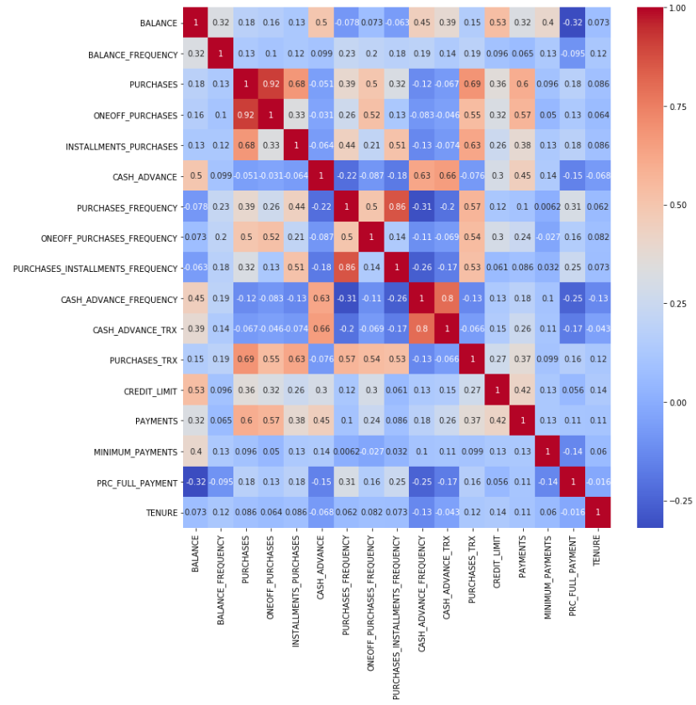
Identifying the attributes which define the customer payment purchase behaviour
By using the correlation matrix plot, the multi – collinearity check is performed
From the matrix: purchases, payments, credit_limit and balance are identified to be correlated and can be further used in the clustering analysis

Slide 9
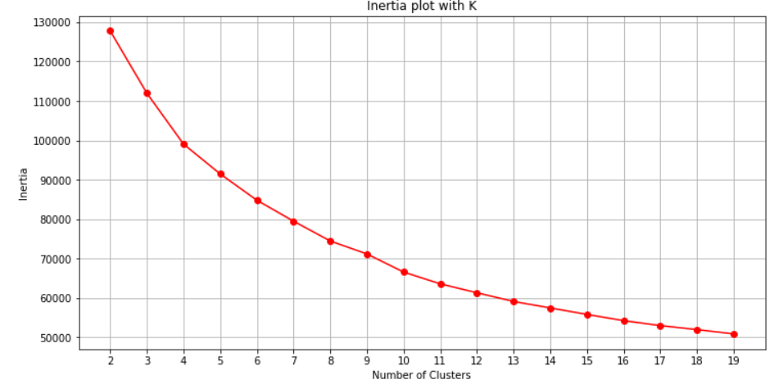
Finding the optimum number of clusters for K-Means Clustering
The optimal number of clusters for the K-Means algorithm is found using the ’Elbow Method’ which computes the sum of squared distances for k clusters
Using inertia_plot function, the elbow curve was plotted for the scaled dataset
From the figure, the optimum number of clusters required are found to be ‘6’

Slide 10
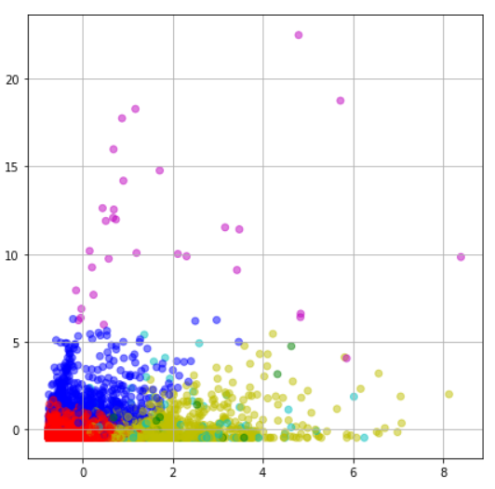
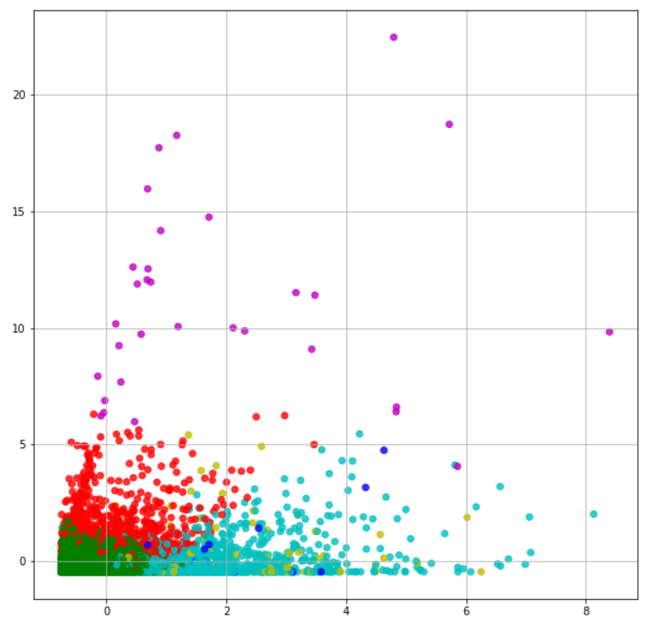
K-Means Clustering for Customer Segmentation
Using scikit-learn machine learning library, K-Means clustering is implemented on the scaled dataset
As per the elbow method, the customers with similar purchasing and payment behaviour are segmented into 6 different clusters
The adjacent scatter plots show 6 different clusters, customer segmentations

Slide 11
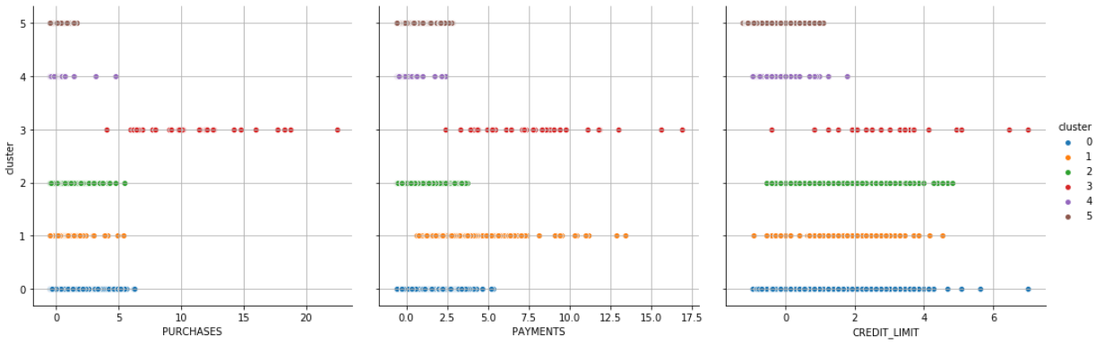
Identifying Max Payers, Ordinary Users and Revolvers
Cluster 0 (Blue):Ordinary Users - This group of users have average purchases and payments, and lowest credit score (*Credit Score - Lower implies customers are maintaining their balance properly)
Cluster 3 (Red):Max Payers - This group of users have highest purchases, highest payments, and low credit score values. They make payments on time
Cluster 2 (Green):Revolvers- This group has the varied purchases, payments, highest minimum payments, but the other features are also wildly varied in values

Slide 12
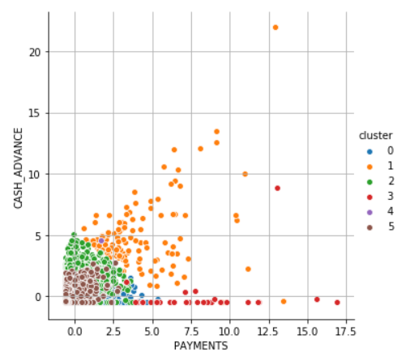
Identifying the ‘Money Borrowers’
Cluster 1 (Orange): Money Borrowers
From the plots, it is noted that the customers who belong to this cluster have wildly varied balance, second highest payments, average purchases
Also, these customers have the highest cash advance by far - there is even one extreme case that has 25 cash advance points

Slide 13
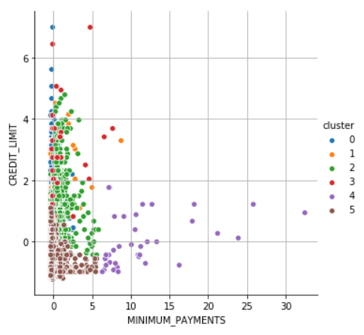
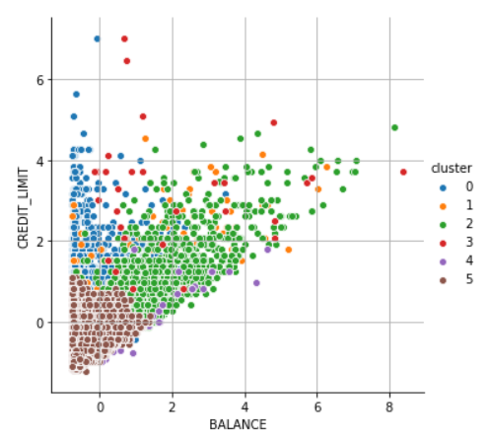
Identifying the High Riskers and Traders
Cluster 4 (Purple): Traders
This group has highest minimum payments while having the second lowest credit limit. Therefore, bank can identify them as Traders
Cluster 5 (Brown): High Riskers
This group is troublesome to analyse as both their credit limit and balance values are low, they have least purchases and payments. They usually delay their payments

Slide 14
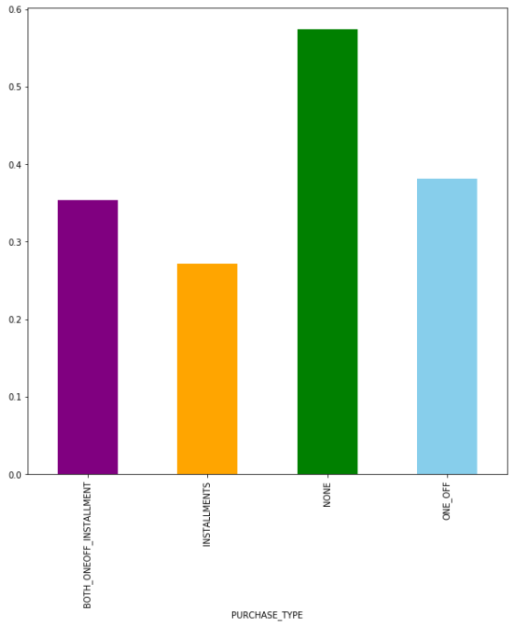
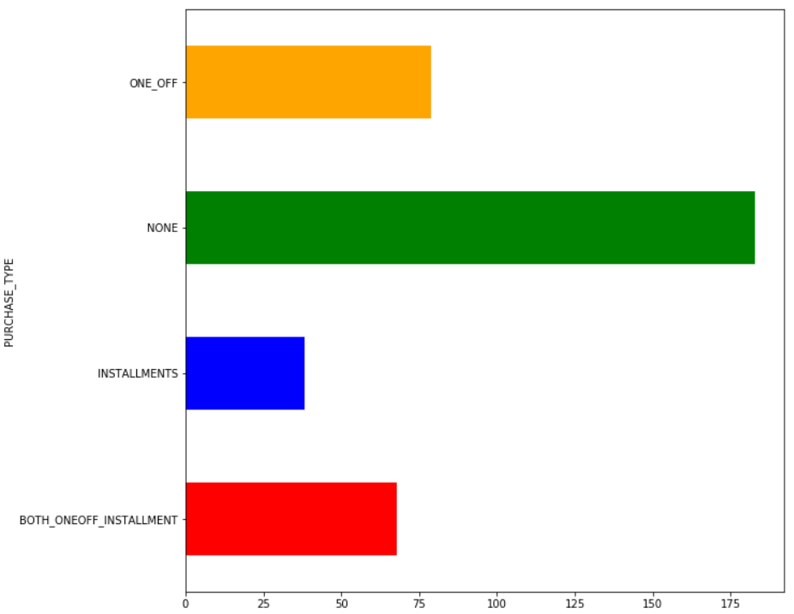
Purchasing Behaviours of Customers
Based on the monthly average cash advance calculated, the customers who do not do ONEOFF or INSTALLMENTS take more cash advance and can be categorized into late payments
Based on the Credit Limit Usage calculated, Customers with installment purchases have good credit score and are paying dues, they make early payments

Slide 15
Limitations
The present analysis is confined to a smaller dataset with less scope on the ‘time of purchases’ made. This attribute will be helpful to detect much more insights on the customer behaviour
Based on the time and demographics of the purchase made, there is a scope to identify if the purchase was made by a trustworthy customer or a fraudulent customer
In order to identify the delinquent customers, the dataset with near 6 months information may not suffice to derive into conclusions

Slide 16
Conclusions
As per the analysis, Max Payers are important to the credit card companies because they make payments on time which allows them to lend out more money
The Ordinary Users do not use credit card much in their daily life. They have healthy finances and low debts. Encouraging these people to use credit cards more is necessary for the company's profit
Revolvers are a type of customers who pay only minimum amount due, and go about making purchases on their cards as usual. The interest rates and late fees these users pay are the bread and butter of the credit card industry
Money Borrowers are the customers who take more cash advances. Companies must look after these users more diligently
Cont’d…

Slide 17
Conclusions
A good way to manage High Riskers is by giving them low credit limits, cash advances with regular follow-up, else they might delay their payments
Traders are the smartest credit card users. They always lookout for cards with maximum rewards, cash back, longest payback tenure etc. Companies can provide offers, cashbacks to attract there customers
Customers with installment payments are paying dues and have good credit score, customers who do not do ONOFF or INSTALLMENTS take more cash advance

Slide 18
Acknowledgements
The dataset was obtained from kaggle website which defines credit customer behaviour with 18 various attributes
No other informal analysis has been used in this work
The data was collected by myself from kaggle website and no feedback has been received
Thanks to the Course Instructors Leo Porter and Ilkay Altinas for their amazing work

Slide 19
References
I have completed the analysis on my own with the help of weekly notebooks provided in the course
The information about different types credit card customers in the banking sector was studied from the following websites:
https://in.finance.yahoo.com/news/5-types-credit-card-users-143051341.html
https://cashmoneylife.com/5-types-of-credit-card-users/
I’m attaching a PDF of my final-project notebook https://github.com/SwethaSripada/PythonNotebooks/blob/master/Credit%20Card%20Customer%20Segmentation.pdf

